Slide 1
Data Visualization
116N54C301
Module 1

Slide 2
Introduction data visualization
Introduction to data visualization and it’s needs. Data analysis lifecycle. A Visual Revolution, Various types of visualization with its best practices. From Visualization to Visual Data Storytelling: An Evolution, From Visual to Story: Bridging the Gap Data Fundamentals, Collecting data, Preparing Data Introduction to basic Visualization and it’s need. The Bar Chart The Line Chart The Pie and Donut Charts The Scatter Plot The Packed Bubble Chart

Slide 3
Books
Sosulski, K. ,”Data Visualization Made Simple: Insights into Becoming Visual”, New York: Routledge. First edition, 2018
Lindy Ryan, “Visual Data Storytelling with Tableau”, Pearson Education First edition, 2018
Cole Nussbaumer Knaflic, “Storytelling with Data”, Wiley First edition,
2015

Slide 4
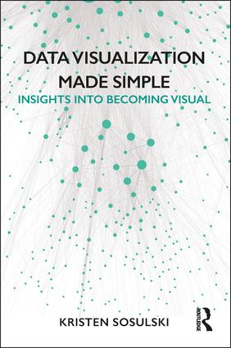
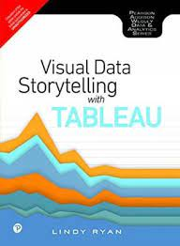
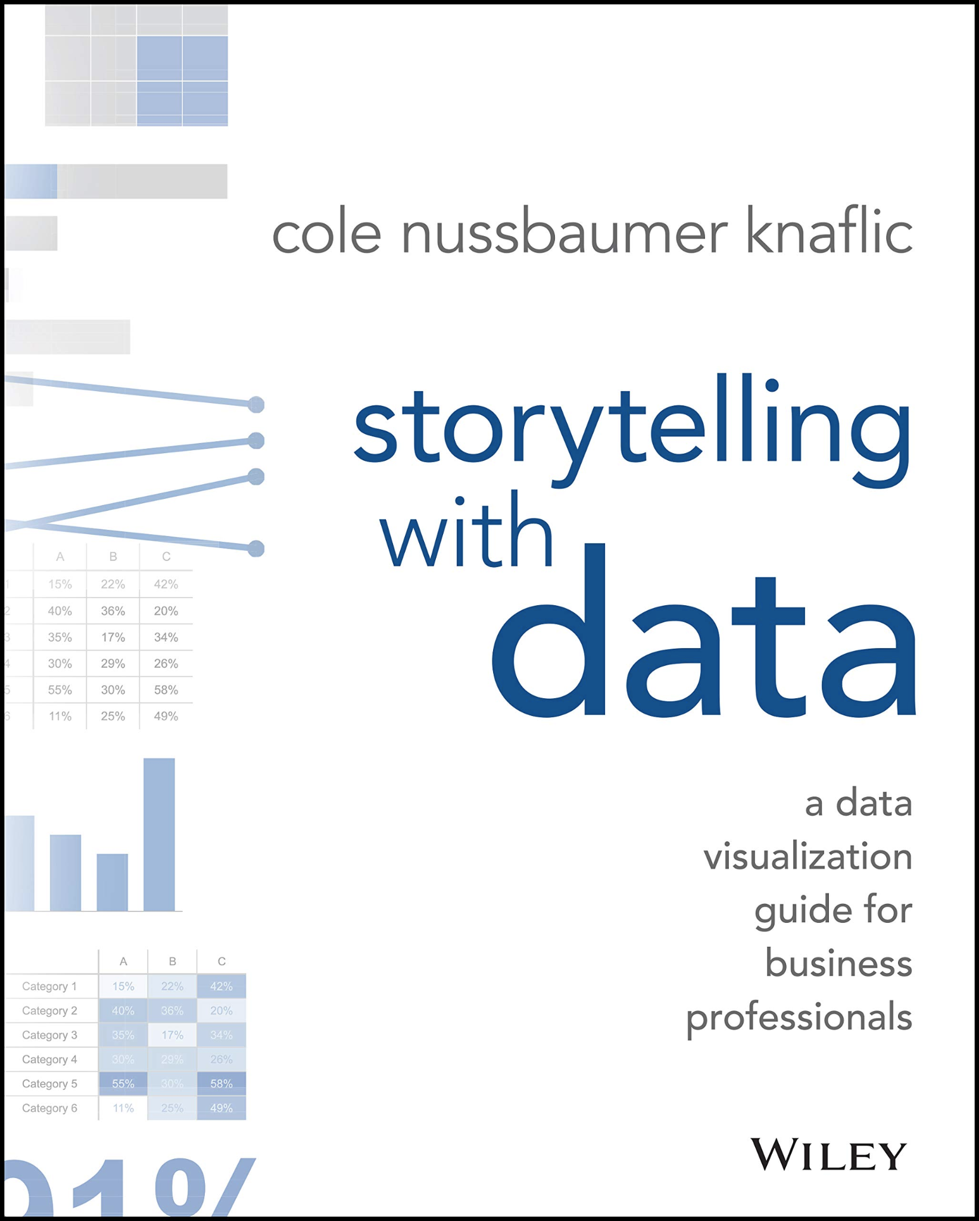

Slide 5
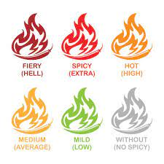
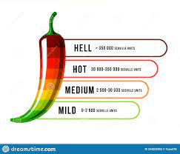
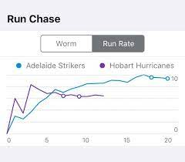
Data Visualization
A picture speaks more than 1000 words
Colors attracts more attention
Non-verbal communication can influence human mind subtly
Universal language has no bar
Vegetarian
Non- Vegetarian

Slide 6
Introduction to data visualization and it’s need
Data visualization:
A graphic representation that expresses the significance of data
Reveals insights and patterns that are not immediately visible in the raw data
An art through which information, numbers, and measurements can be made easy to understand and manipulate making the information useful
Primary goal is to communicate information clearly and effectively through graphical means
Pictorial format representing some form of collected data which would help in making decision or navigation

Slide 7
Introduction to data visualization and it’s need
Data visualization:
65% of the audience is visual learner
Easy to retain
80% of what we see compared to 20% of what we read 0% of what we hear
It takes just 1/10 seconds for brain to process as an image
Pictures would help in
Decision making
Uncovering patterns and trends
Presenting arguments or telling story

Slide 8
Introduction to data visualization and it’s need
Data visualization:
65% of the audience is visual learner
Tools for Visual Learners
Use mind pictures or mind maps
Take notes
Use "clue" words for recalling
Use colored highlighters to color code texts and notes
Use maps, charts, diagrams, and lists
Watch audiovisuals
Take photographs
Use study cards or flashcards
Use notebooks
Watch instructor's mouth and face
Use visual chains or mnemonics
Watch TV
See parts of words
Write down directions

Slide 9
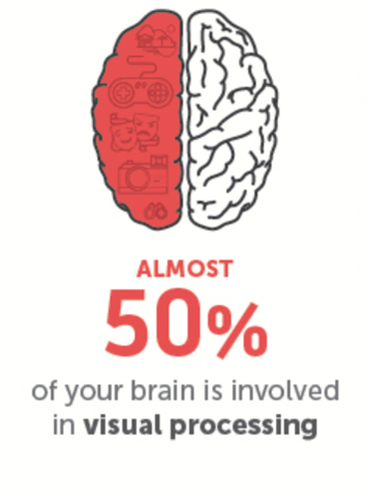
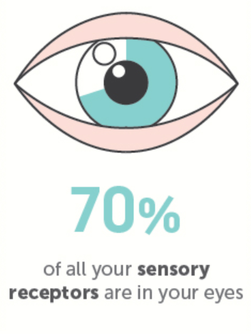

Introduction to data visualization and it’s need
Data visualization:
Easy to retain
80% of what we see compared to 20% of what we read 10% of what we hear

Slide 10
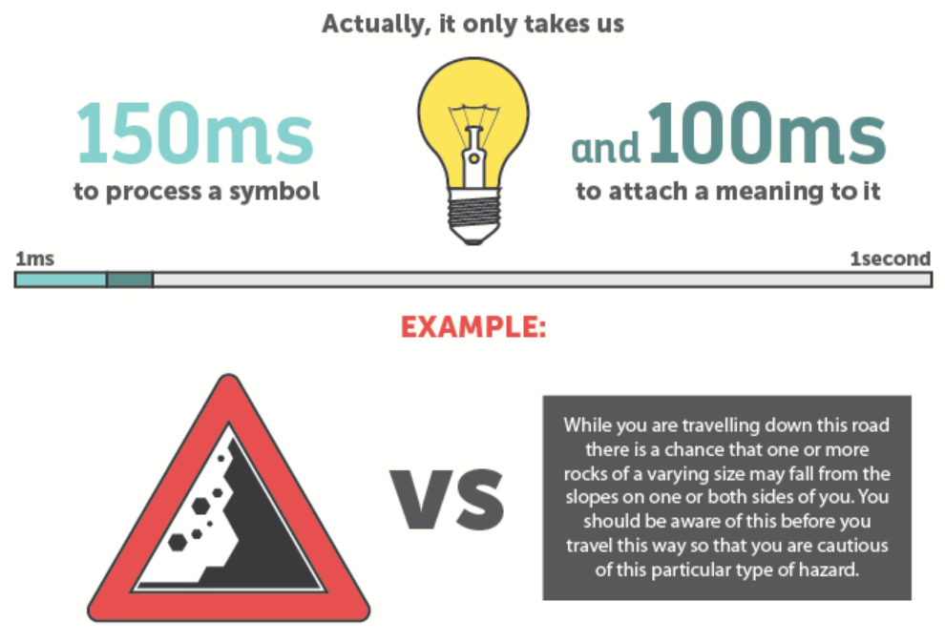
Introduction to data visualization and it’s need
Data visualization:
Easy to retain
80% of what we see compared to 20% of what we read 10% of what we hear

Slide 11

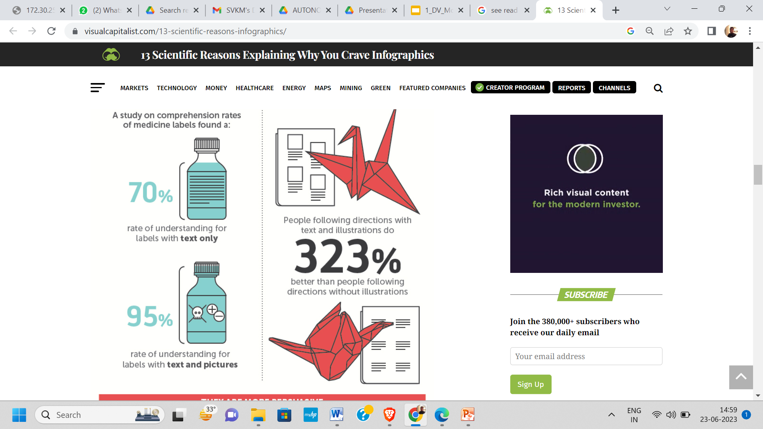
Introduction to data visualization and it’s need
Data visualization:
Easy to retain
80% of what we see compared to 20% of what we read 10% of what we hear

Slide 12
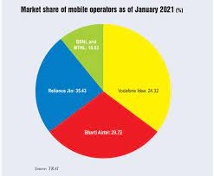
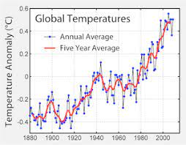
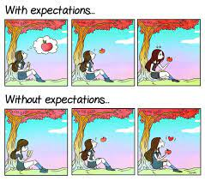
Introduction to data visualization and it’s need
Data visualization:
It takes just 1/10 seconds for brain to process as an image
Pictures would help in
Decision making
Uncovering patterns and trends
Presenting arguments or telling story

Slide 13
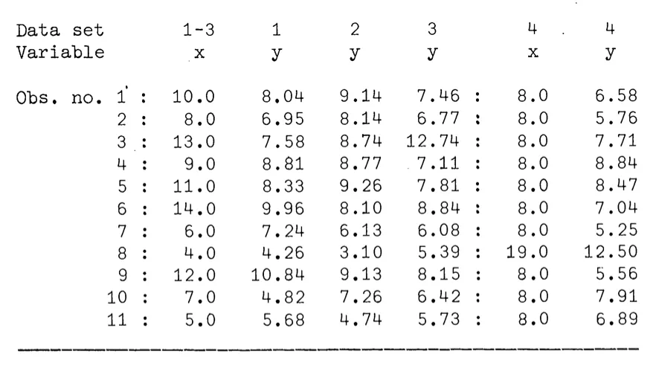
Importance of data visualisation

Slide 14
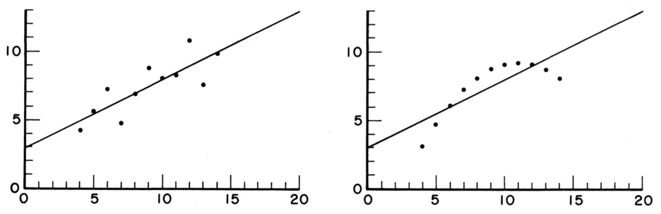
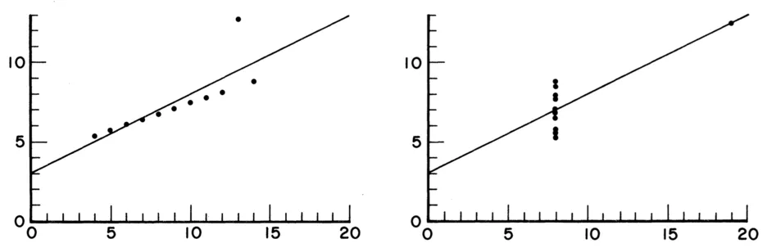
Same data presented in graphical form

Slide 15
Visualization steps
Data acquisition
Data generated/ collected
Data processed
Data mapped to visual primitive; (color, geometry etc.)
Images generated
Data enhancement
Visualization mapping
Rendering (ND to 2D)

Slide 16
Types of Visualisation
Scientific Visualisation SciVis:
used for the clarification of well-known phenomena
Information Visualisation InfoVis:
used for searching for interesting phenomena

Slide 17
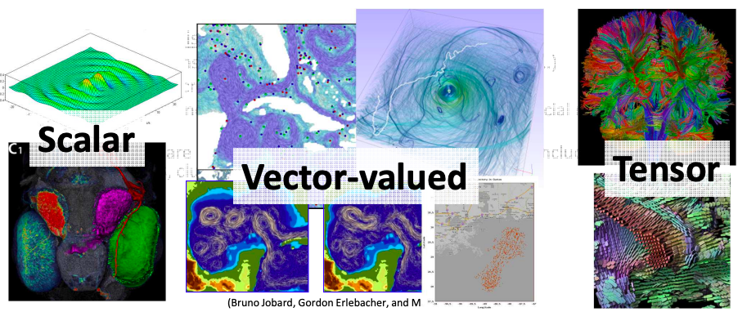
SciVis vs. InfoVis
• Scientific visualization is mostly concerned with: –
Data defined in physical space, i.e. spatio-temporal data (2~4 dimensions)
Data describes continuous events in continuous space, however, the representation is discrete (i.e. sampled data)
Examples include simulation and measurement data from physics, chemistry, geo-science, medical-biological, climate, oceanography, energy, ……
Features are well-defined

Slide 18
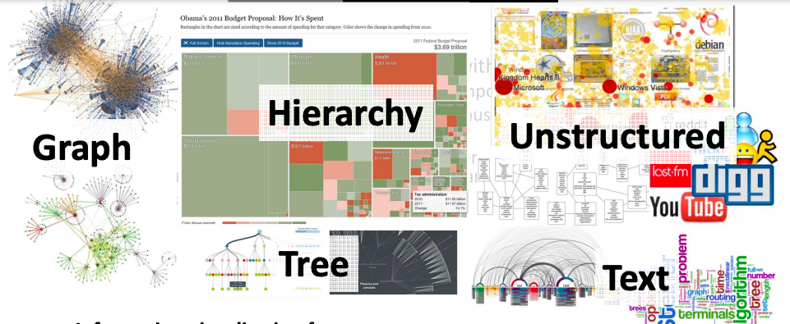
SciVis vs. InfoVis
• Information visualization focuses on:
high-dimensional (>>4), abstract data (i.e. tree, graphs, hierarchy, …)
Data is discrete in the nature
Examples include financial, marketing, HR, statistical, social media, political, …...
Feature are not well-defined, the typical analysis tasks including finding patterns, clusters, voids, outliers

Slide 19
Need of Data Visualization
Data visualization helps to tell stories by curating data into a form easier to understand, highlighting the trends and outliers.
Analysing the Data in a Better way
Data visualization can help by delivering data in the most efficient way possible.
Data visualization takes the raw data, models it, and delivers the data so that conclusions can be reached.
Faster Decision Making
Data visualization uses visual data to communicate information in a manner that is universal, fast, and effective.
Making Sense of Complicated Data
Data visualization positively affects an organization’s decision-making process with interactive visual representations of data.

Slide 20
Google form to collect Data
Sample Responses (Excel format)
Sample Responses Graphical form

Slide 21
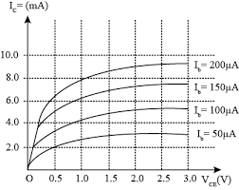
Need of Data Visualization
Businesses can now recognize patterns more quickly because they can interpret data in graphical or pictorial forms.
Correlations in Relationships: Without data visualization, it is challenging to identify the correlations between the relationship of independent variables. Make better business decisions by making sense of those independent variables.

Slide 22
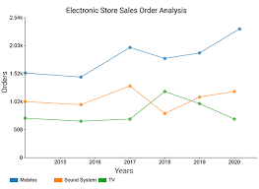
Need of Data Visualization
Businesses can now recognize patterns more quickly because they can interpret data in graphical or pictorial forms.
Trends Over Time: an obvious and one of the most valuable applications use of data visualization It’s impossible to make predictions without having the necessary information from the past and present. Trends over time tell where we were and where we can potentially go.

Slide 23
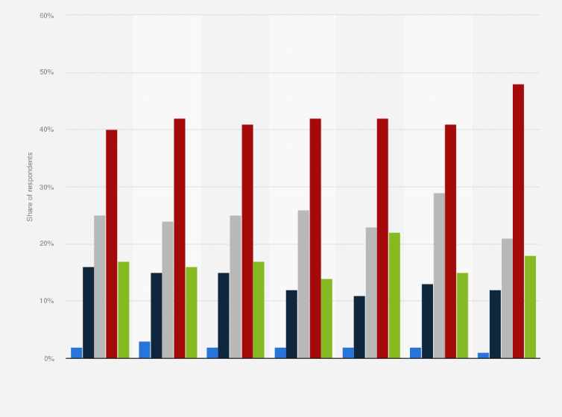
Need of Data Visualization
Businesses can now recognize patterns more quickly because they can interpret data in graphical or pictorial forms.
Frequency: Closely related to trends over time is frequency. By examining the rate, or how often, customers purchase and when they buy gives a better feel for how potential new customers might act and react to different marketing and customer acquisition strategies.

Slide 24
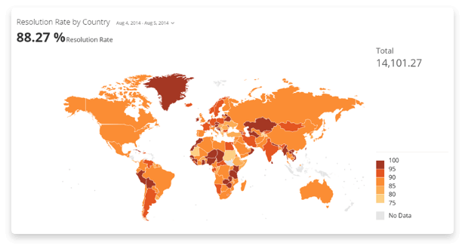
Need of Data Visualization
Businesses can now recognize patterns more quickly because they can interpret data in graphical or pictorial forms.
Examining the Market: Data visualization takes the information from different markets to give you insights into which audiences to focus your attention on and which ones to stay away from. We get a clearer picture of the opportunities within those markets by displaying this data on various charts and graphs.

Slide 25
Need of Data Visualization
Businesses can now recognize patterns more quickly because they can interpret data in graphical or pictorial forms.
Correlations in Relationships:
Trends Over Time:
Frequency:
Examining the Market:

Slide 26
Need of Data Visualization
Risk and Reward: Looking at value and risk metrics requires expertise because, without data visualization, we must interpret complicated spreadsheets and numbers. Once information is visualized, we can then pinpoint areas that may or may not require action.
Reacting to the Market: The ability to obtain information quickly and easily with data displayed clearly on a functional dashboard allows businesses to act and respond to findings swiftly and helps to avoid making mistakes.
Data visualization helps to tell stories by curating data into a form easier to understand, highlighting the trends and outliers
A good visualization tells a story, removing the noise from data and highlighting the useful information
Effective data visualization is a delicate balancing act between form and function
The most stunning visualization could utterly fail at conveying the right message or it could speak volumes
The data and the visuals need to work together

Slide 27
Data Analysis Lifecycle
Objective
Understanding the data
Data Visualisation
Data Analytics
Data Cleaning & Transformation
Data Enhancing

Slide 28
Data Analysis Lifecycle
Objective
Identify WHY is the data collected.
The purpose of data collection decides WHAT to collect and HOW and from WHOM and to WHOM will that be presented
Understanding the Data
Know WHAT is collected
Data Cleaning & Data Transformation
Remove the UNWANTED data (noise) which may be irrelevant
Convert data from one form to another if needed
Data Enhancing
Identify the distinguishing features of the data and highlight them
Data Analytics
Model the data for presentation
Interpret the data
Data Visualisation
Present the data to the end user in the way (s)he will use to gain

Slide 29
Data Analytics Lifecycle
Data Discovery and Formation
Identify data’s purpose and how to achieve it
Consists of mapping out the potential use and requirement of data,
Source of information; Where the information is coming from
What story you want your data to convey
How your organization benefits from the incoming data
Focus on enterprise requirements related to data, rather than data itself
Assessing the tools and systems that are necessary to read, organize, and process all the incoming data.
The data science team learn and investigate the problem.
Develop context and understanding.
Come to know about data sources needed and available for the project.
The team formulates initial hypothesis that can be later tested with data

Slide 30
Data Analytics Lifecycle
Data Discovery and Formation
Data Preparation
Steps to explore, preprocess, and condition data prior to modeling and analysis.
Execute, load, and transform the data
Tasks could be performed multiple times and not in predefined order
Several tools commonly used for this phase are – Hadoop, Alpine Miner, Open Refine, etc.
Model Planning
Data is explored to learn about relationships between variables and subsequently, selects key variables and the most suitable models.
Data science team develop data sets for training, testing, and production purposes
Team builds and executes models based on the work done in the model planning phase.
Several tools commonly used for this phase are – Matlab, STASTICA.

Slide 31
Data Analytics Lifecycle
Data Discovery and Formation
Data Preparation
Model Planning
Model Building
Team develops datasets for testing, training, and production purposes.
Team also considers whether its existing tools will suffice for running the models or if they need more robust environment for executing models.
Free or open-source tools – Rand PL/R, Octave, WEKA.
Commercial tools – Matlab , STASTICA.
Communication of Results
After executing model team need to compare outcomes of modeling to criteria established for success and failure.
Team considers how best to articulate findings and outcomes to various team members and stakeholders, taking into account warning, assumptions.
Team should identify key findings, quantify business value, and develop narrative to summarize and convey findings to stakeholders.

Slide 32
Data Analytics Lifecycle
Data Discovery and Formation
Data Preparation
Model Planning
Model Building
Communication of Results
Optimization
The team communicates benefits of project more broadly and sets up pilot project to deploy work in controlled way before broadening the work to full enterprise of users.
This approach enables team to learn about performance and related constraints of the model in production environment on small scale , and make adjustments before full deployment.
The team delivers final reports, briefings, codes.
Free or open source tools – Octave, WEKA, SQL, MADlib.

Slide 33
Visual Revolution, Various types of visualization with its best practices.
A 'Visual Revolution' is changing the way we communicate
Use all kind of visuals - images, graphics, videos and animations to create emotional connections
Make sure your content is unique so that people will remember for longer duration, creating impact
Create visuals that are useful to customers, or other supporters
Invite other people to share their images to encourage interaction and engagement
Include short captions with your visuals to give context or include a call to action that asks people to take the next step

Slide 34
Visualization best practices
With explosion in volume and complexity of data generated, use of data visualitzation becomes essential
Human processes visual information better than tables, numbers, and text
Converting into graphs and charts data is transformed into easy-to -understand form

Slide 35
Data Types
Numeric / alpha numeric / Images/ Audio
Numeric Data:
Categories based on measurement scale:
Nominal Scale (qualitative variable or categorical variable). NO arithmetic operations are possible
e.g blood group : A, B, AB & O
Ordinal Scale: (values are captured from an ordered set). Order is fixed and no arithmetic operations can be performed
e.g. review ratings on a Likert scale (1-5, 5 being highest )
Interval Scale: (Data points taken from a fixed interval set) Cannot perform ratios on interval scale data
e.g. 50 degree C is not twice hot as 25 degree C
Ratio Scale: Arithmetic operations are possible
Product sales, salary

Slide 36
Data Types & Operations
Data Type | Operations
Nominal | Can only check if the values are same or not (= = or !=)
Ordinal | Can compare ( ==, != , < , >)
Interval | Can measure distance or span with operations ( ==, !=, < , > ,-)
Ratio | Can measure proportions with operations (== ,!=, < , > ,+, - ,%)

Slide 37
From Visualization to Visual Data Storytelling: An Evolution
Data visualization will depend on statistical understanding of the data, its context and to measure it to avoid false analysis and skewed decision making
Human visual cognition system demands a way to encode numbers with meaning by relying on colours and shapes to support interpretation
Data visualization is the best way to see and understand huge, most diverse data

Slide 38
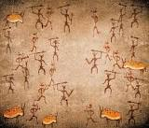
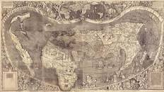

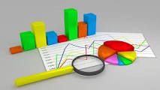
From Visualization to Visual Data Storytelling An Evolution
Data visualization
Cave drawings
Early Maps
Modern Maps
Statistical graphs

Slide 39
From Visualization to Visual Data Storytelling An Evolution
Data visualization aided by:
Advancement in visual design
Cognitive science
Technology and
Business intelligence
An emerging new approach to storytelling attempts to combine data with graphics and tell the world’s stories through the power of information visualization.

Slide 40
From Visualization to Visual Data Storytelling: An Evolution
Evidence of the cognitive effects of storytelling in neurology is it’s a central way that we learn, remember, and communicate information.
Important goal of visual story is to prepare business decision makers to leave a data presentation with a story in their head that helps them both to remember your message and take action on it.
Data stories provide tool to communicate information in ways the facts and figures alone can’t.

Slide 41
From Visualization to Visual Data Storytelling: An Evolution
Storytelling Process

Slide 42
From Visual to Story: Bridging the Gap
Data Storytelling is needed as amount of data is growing day-by-day
Steps
Create Data
Collect Data
Clean/ Prepare Data
Present Data (Visualization)
Storytelling (Communication)

Slide 43
Data Visualization V/s Data Storytelling
Data visualization: the practice of graphically representing data to help people see and understand patterns, insights, and other discoveries hidden inside information
Data storytelling: translate seeing into meaning by weaving a narrative around the data to answer questions and support decision making

Slide 44
Digital Storytelling
Process of using Digital Technology to communicate to aid taking decision making
Process of Storytelling:
Use of media
Text,
Visuals
Music
Video
Voice
To reach to wider audience in more convincing way

Slide 45

Digital Storytelling
Data:
How to prepare pasta :
Ingredients
Process/ Procedure
Visualisation:
Use images to express
Presentation:
Use presentation to create long lasting impression

Slide 46
Data Fundamentals, Collecting data, Preparing Data
Data Fundamental:
Primary Data:
Collected afresh
Need to validate the process and collected information
Secondary Data:
Collected by some one
Validity/ relevance may be checked

Slide 47
Data Fundamentals, Collecting data, Preparing Data
Collecting data:
Primary Data:
Survey
Descriptive research
Observation: systematic viewing
Direct Communication
Personal Interviews
Secondary Data:
Download from reliable source

Slide 48
Data Fundamentals, Collecting data, Preparing Data
Collecting data:
Primary Data:
Advantages
Unbiased data
Fresh Information
Relevant information could be captured
Limitations:
Time consuming
Costly
Limited scope

Slide 49
Data Fundamentals, Collecting data, Preparing Data
Collecting Primary data:
Types of observation:
Structured:
Standard conditions
Well prepared
Forms/ formats
Checklist
Unstructured:
Without much preparation

Slide 50
Introduction data visualization
Introduction to basic Visualization and it’s need. The Bar Chart The Line Chart The Pie and Donut Charts The Scatter Plot The Packed Bubble Chart

Slide 51
Charts
The Bar Chart
The Line Chart
The Pie and Donut Charts
The Scatter Plot
The Packed Bubble Chart

Slide 52
Charts: The Bar Chart
The bar chart is one of the most common ways to visualize data.
Used to compare numerical values using the length of the bar.
It is best suited for numerical data that can be divided into distinct categories to compare information and reveal trends at a glance.
Bars can be oriented on the vertical or horizontal axis, which can be helpful for spotting trends.
Additional layers of information can be added using clustered bars or by stacking related data.
Color can be added for more impact or to overlay for immediate insight.
Trend lines and other annotations can be added to highlight important data points.

Slide 53
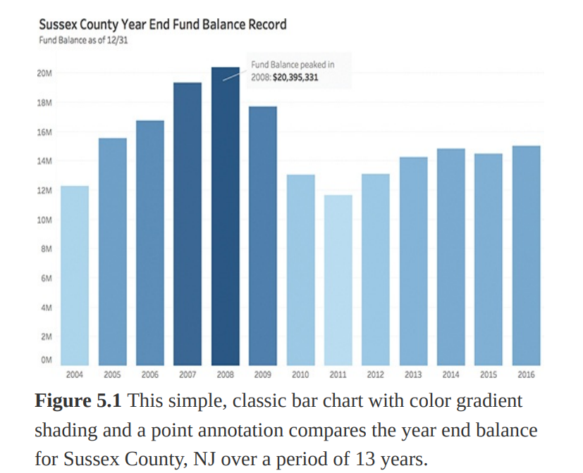
Charts

Slide 54
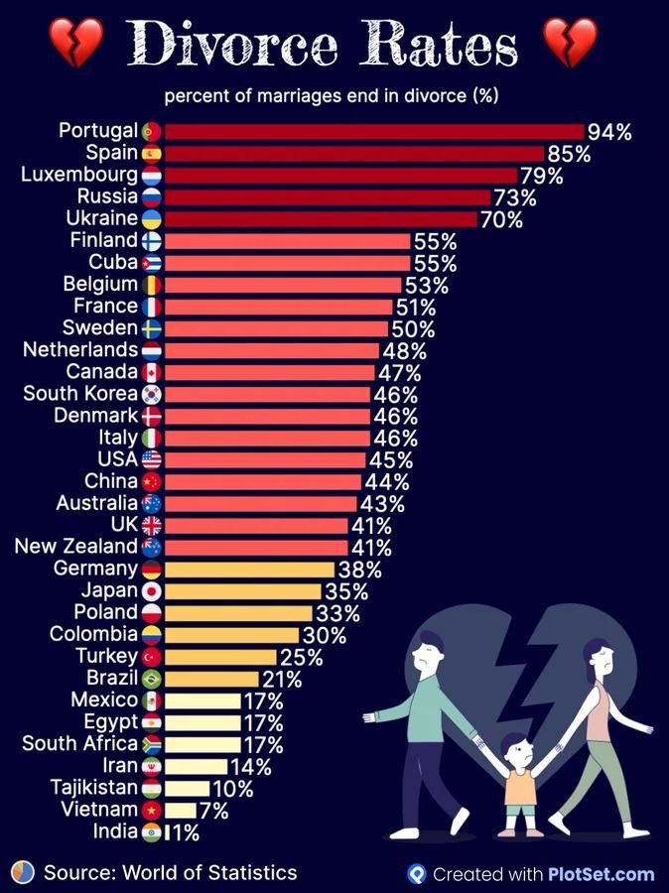
Horizontal Bars

Slide 55
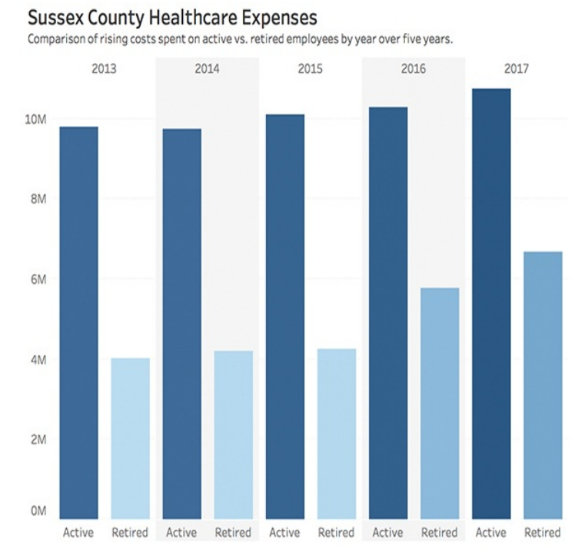
Comparison using bars

Slide 56
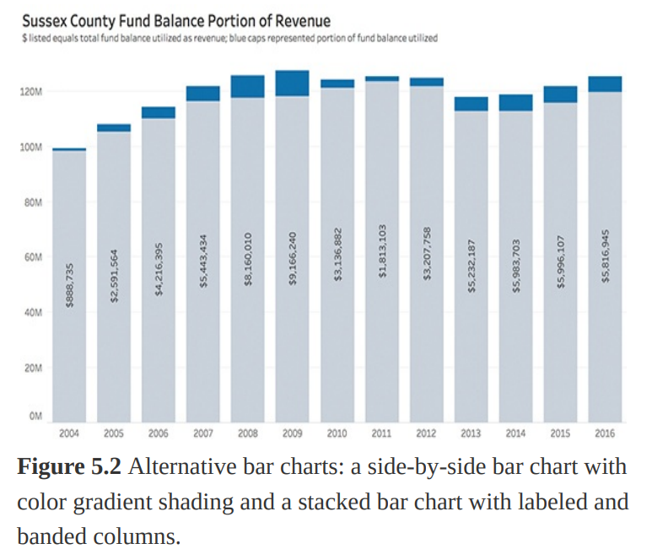
Stacked bar chart

Slide 57
Charts
The Bar Chart
Advantages:
show each data category in a frequency distribution.
display relative numbers or proportions of multiple categories.
summarize a large data set in visual form.
clarify trends better than do tables.
estimate key values at a glance.
permit a visual check of the accuracy and reasonableness of calculations.

Slide 58
Charts
The Bar Chart
Limitations
Requires additional written or verbal explanation
By cleverly choosing the scale of the bar graph some scammers can make sure that one of the bars seems higher relative to the other
Fails to reveal assumptions, causes, and effects
Not Suitable if there are large number of categories

Slide 59
Charts
The Line Chart
A line chart is a type of chart that displays information as a series of data points connected by straight line segments.
They are most commonly used when an element of time is present.

Slide 60
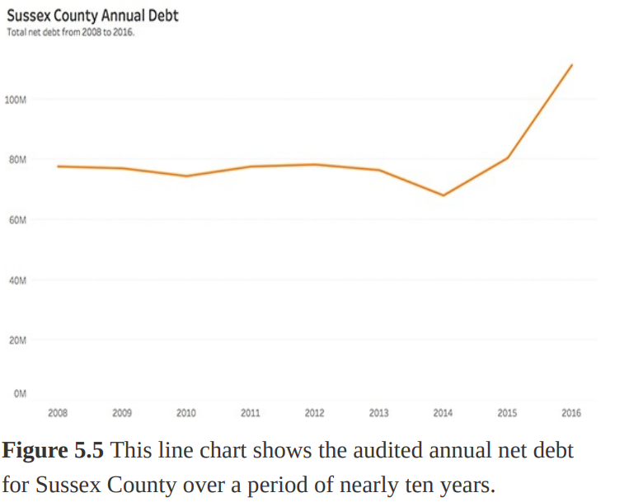
The Line Chart
The best use case for line charts involves displaying trends over a period of time , when your data are ordered, or when interpolation makes sense.

Slide 61
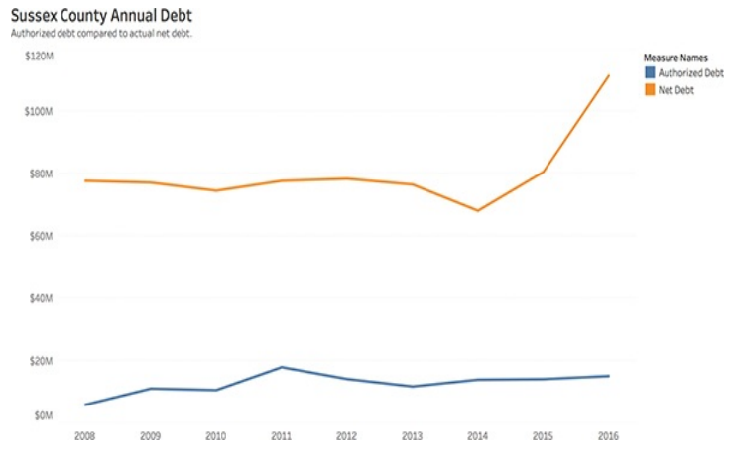
The Line Chart
Dual-axis line charts can be created by bringing two measures to the rows shelf, and then right-clicking on the second measure and selecting Dual-axis from the drop-down menu.

Slide 62
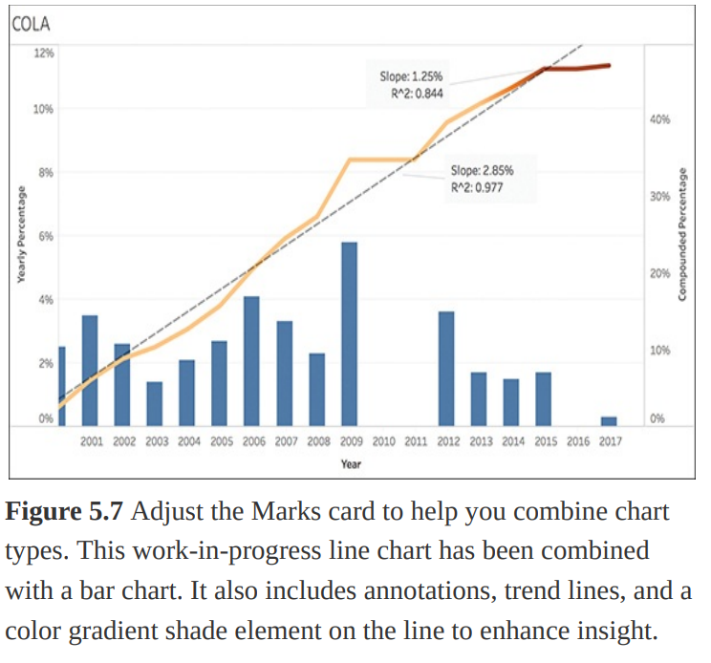
The Line Chart
Additionally, when two or more lines are present, you can transform line charts by adding additional chart types to deepen insight. For example, a line chart can be combined with a bar chart to provide visual cues for further investigation.

Slide 63
Charts
The Line Chart
Advantages:
Easy to show the data changes over time over a line graph.
Helps in showing small changes that are difficult to measure in other graphs.
A relationship between 2 or more variables get identified.
It presents a good impression of trends and changes.
Both negative, as well as positive values, are indicated.

Slide 64
Charts
The Line Chart
Limitations:
Plotting too many lines over the graph makes it cluttered and confusing to read.
A wide range of data is challenging to plot over a line graph.
They are only ideal for representing data made of total figures such as values of total rainfall in a month.

Slide 65
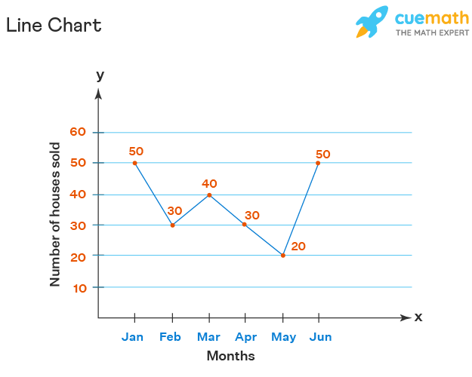
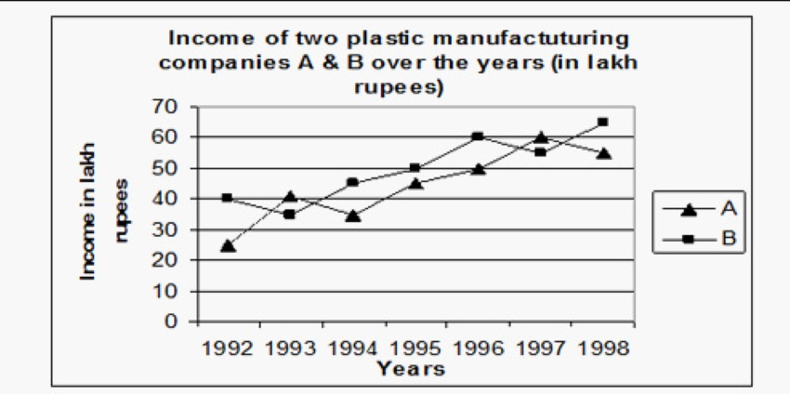
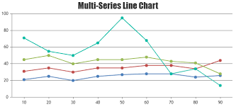

Slide 66
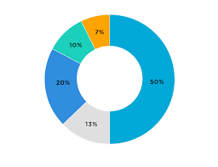
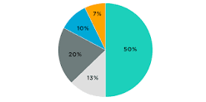
The Pie and Donut Charts:
A pie chart (or a circle chart) is a circular statistical graphic, which is divided into slices to illustrate numerical proportion.
Donut charts can help clarify your data story by including a key takeaway in the center white space

Slide 67
Charts
The Pie and Donut Charts:
Advantages :
A simple and easy-to-understand picture.
It represents data visually as a fractional part of a whole, which can be an effective communication tool for the even uninformed audience.
It enables the audience to see a data comparison at a glance to make an immediate analysis or to understand information quickly.
The need for readers to examine or measure underlying numbers themselves can be removed by using this chart.
To emphasize points you want to make, you can manipulate pieces of data in the pie chart.

Slide 68
Charts
The Pie and Donut Charts:
Limitations:
They cannot show more than a few values, because as the number of values shown increases, the size of each segment/slice becomes smaller. This makes them unsuitable for large amounts of data.
They take up more space than their alternatives, like a 100% Stacked Bar Chart for example. Mainly due to their size and for the usual need for a legend.
They are not great for making accurate comparisons between groups of Pie Charts. This being that it is harder to distinguish the size of items via area when it is for length.

Slide 69
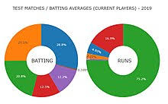
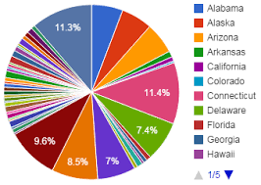

Slide 70
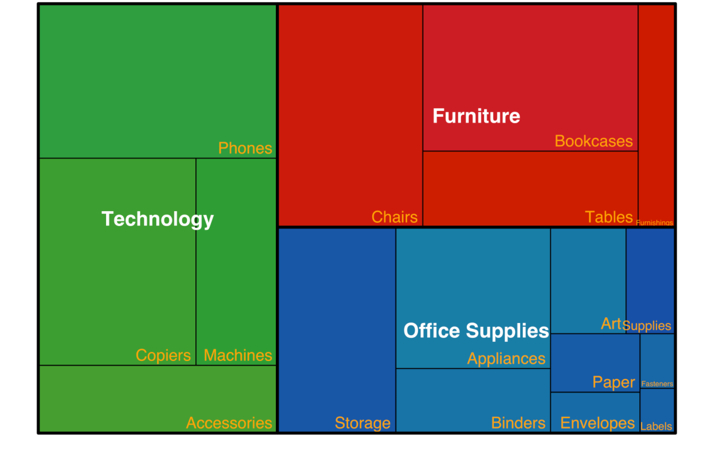
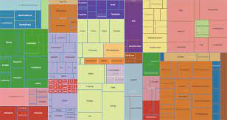
Treemap an alterative to pie

Slide 71
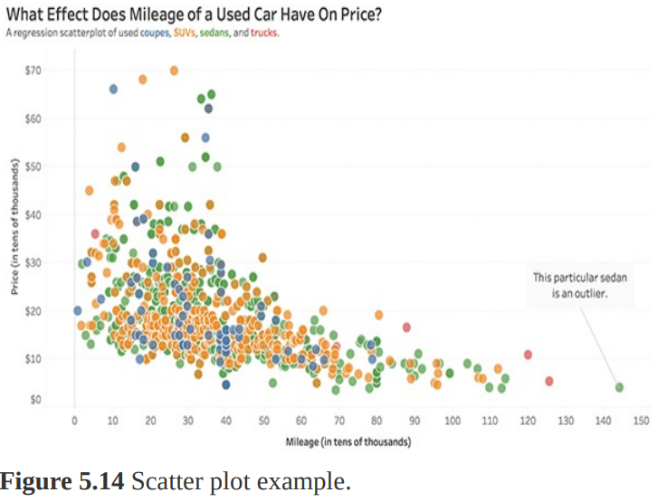
The Scatter Plot

Slide 72
Charts
The Scatter Plot
Scatter plots are an effective way to visualize numerical variables to compare measures and quickly identify patterns, trends, concentrations (clusters), and outliers.
These charts can give viewers a sense of where to focus discovery efforts further and are best used to investigate relationships between variables.
Scatter plots are particularly useful when exploring statistical relationships such as linear regression.
Use a scatter plot to determine whether or not two variables have a relationship or correlation.

Slide 73
Charts
The Scatter Plot
Advantages:
It shows the relationship between two variables.
It is the best method to show you a non-linear pattern.
The range of data flow, like the maximum and minimum value, can be determined.
Patterns are easy to observe.
Plotting the diagram is simple.

Slide 74
Charts
The Scatter Plot
Limitations:
Scatter plot does not show the relationship for more than two variables.
Scatter plots are unable to give the exact extent of correlation.
Scatter plot doesn't show the quantitative measure of the relationship between the two variables.

Slide 75
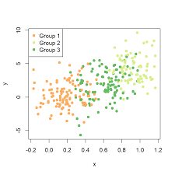

Slide 76
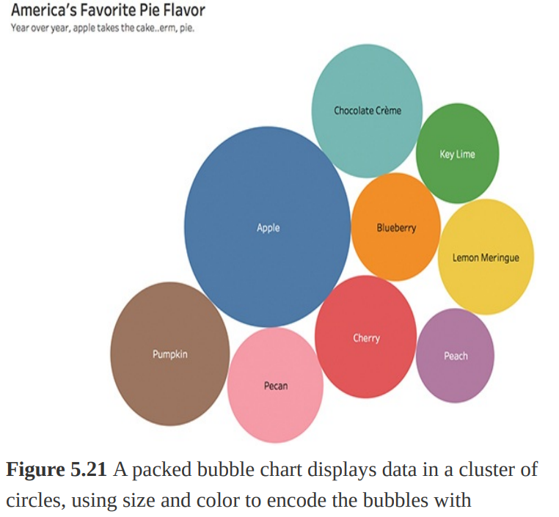
The Packed Bubble Chart
Packed bubble charts are visualizations where the size and optionally the color of the bubbles are used to visualize the data.

Slide 77
The Packed Bubble Chart
The bubble chart is a variation of the scatter plot that replaces data points with a cluster of circles (or bubbles), a technique that further emphasizes data that would be rendered on a pie chart, scatter plot, or map.
This method shows relational values without regard to axes and is used to display three dimensions of data: two through the bubble’s location and another through size.
These charts allow for the comparison of entities in terms of their relative positions with respect to each numeric axis and size.
The sizes of the bubbles provide details about the data, and colors can be used as an additional encoding cue to answer many questions about the data at once.

Slide 78
Charts
The Packed Bubble Chart
Advantages:
Explaining a complex data set easily.
Analyzing data sets with multiple inputs more easily.
Helping to visualize patterns and uncover trends using data analysis.
Helping to correlate data as part of a data series.
Being dynamic enough to analyze finance, sales and marketing scenarios beyond time-series or whole-to-whole comparisons using line and bar charts.
Effectively displaying a relatively large amount of information.
Depicting the relationship between three or even four variables that can change over time without having to use 3D graphs.

Slide 79
Charts
The Packed Bubble Chart
Limitations
A bubble chart can become difficult to understand.
The overlapping of bubbles can make it difficult to distinguish them.
Users may find it hard to depict zero or negative values.
It can be hard to ascertain exact values using circle sizes.

Slide 80
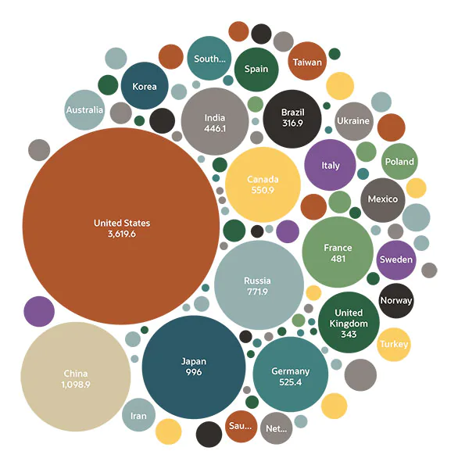
Charts

